Slide 1
OPERATING SYSTEM Enhancing Security Levels In Automatic Teller Machines (ATM) Using Biometric and Multifactor Authentication
BY BRYAN CHAU & BINH LE

Slide 2
INTRODUCTION
Abstract/keywords: PIN, Fingerprint-based, biometric authentication, verification, ATM, Multifactor
Notes:
Each individual has various checking/saving accounts in different banks; individuals need to bring numerous ATM cards for purchase, there might be various PINs for each account. Simultaneously, numerous ATM thefts are happening, regardless of whether the CCTV cameras are put in the ATM. The ATM has endured much over the course of the years against PIN theft and other related ATM scams because of its conventional authentication mode (PIN). The purpose of this project is to propose a multifactor authentication such as a biometric-based fingerprint verification to overcome the security in the traditional ATM systems and protect its user identification.

Slide 3
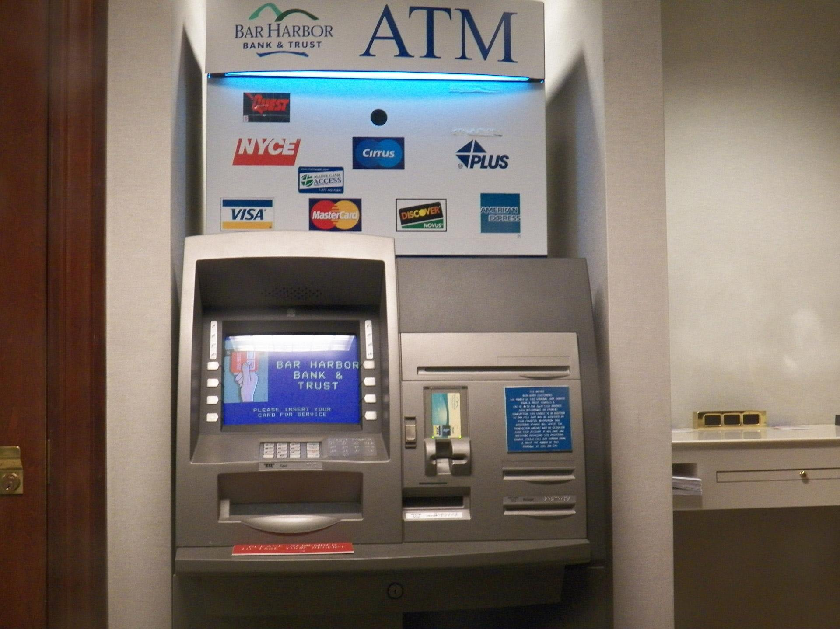
ATM definition?
What is an ATM?
Automated Teller Machine
An an electronic banking outlet that allows customers to complete basic transactions without the aid of a branch representative or teller.
Some latest ATMs are equipped with mobile cash exchanges.
Are broadly utilized due to their easy and speedily accessible money for everybody.

Slide 4
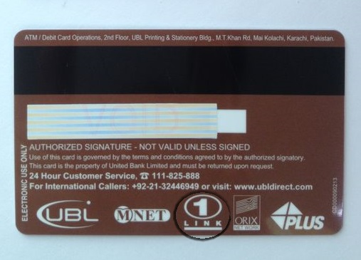
CREDIT CARD
Banks provide customers ATM cards, debit cards, or credit cards to make daily transactions.
The "stripe" contains embedded information that identifies its user.

Slide 5
RELATED-WORK
System flow diagram for ATM using Biometric Fingerprint-based

Slide 6
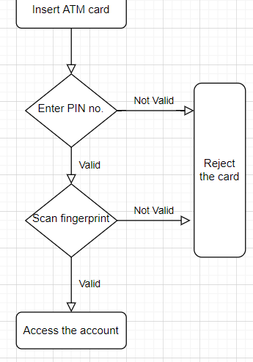
SYSTEM FLOW DIAGRAM
BASIC DIAGRAM

Slide 7
METHOD
Planning a proficient biometric ATM solution for banking transaction with the end goal that, a person's biometric fingerprint will be scanned and captured when opening a bank account.

Slide 8
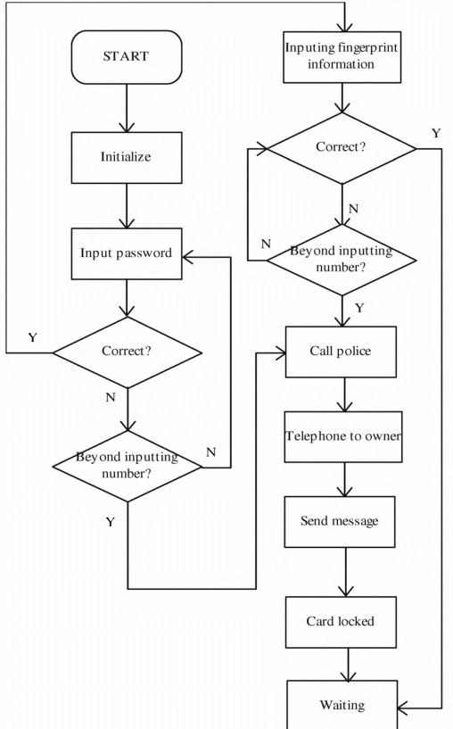
SOFTWARE DESIGN

Slide 9
Fingerprint recognition process
Securing the finger scan picture by the above device referenced in the algorithms.
Pre-handling steps after acquiring the finger scan pictures:
- Separating
- Histogram processing
- Image improvement
- Image binarization
The result of the above measures would be analyzed with the data of the owner’s fingerprint in the database to confirm whether the person is matched. Afterward, the system returned the outcomes, whether they were verified or not.

Slide 10
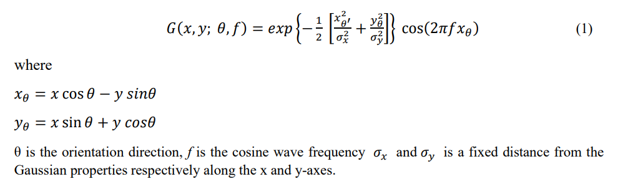
Fingerprint Enhancement
The Gabor Filtering is one of the most widely applied to fingerprint image filtering algorithms.
Are formed from two components, sinusoidal and Gaussian
Is able to connect the optimal representation of orientation direction and the spatial domain (frequency).
the function was defined in 1-D with t stating time and then developed into 2-D in the spatial domain formulated the following equation (1):

Slide 11
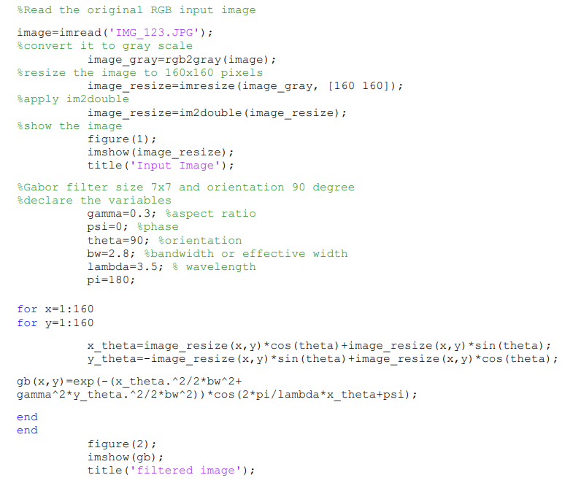
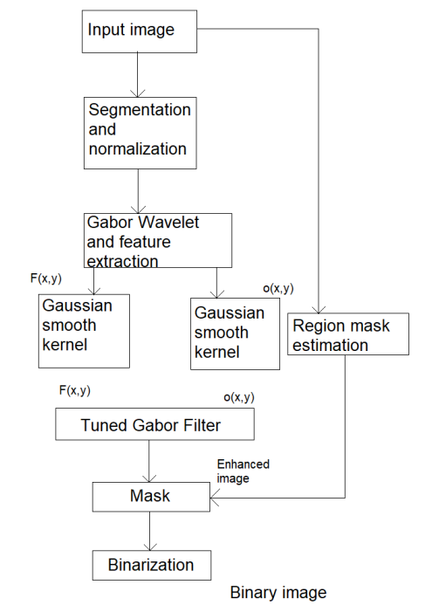
Fingerprint Enhancement

Slide 12
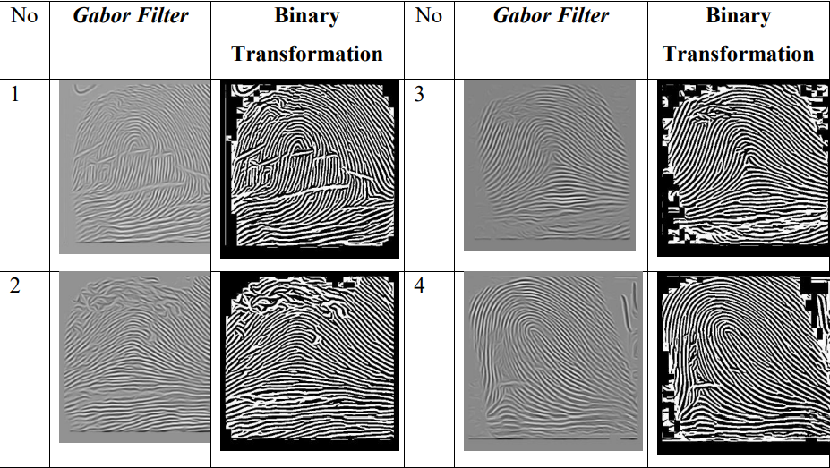
Fingerprint Enhancement
Result of Gabor Filter compared with Binary Transformation
Notes:
Fingerprint improvement calculation dependent on the Gabor filter could be more intelligent to eliminate clamor, reinforce the definition between the ridge and valley, and further develop the image improvement handling limit. Yet, this algorithm was delayed in managing the high capacity prerequisites. The algorithm depends on the Gabor filter being utilized in the recoverable area.

Slide 13

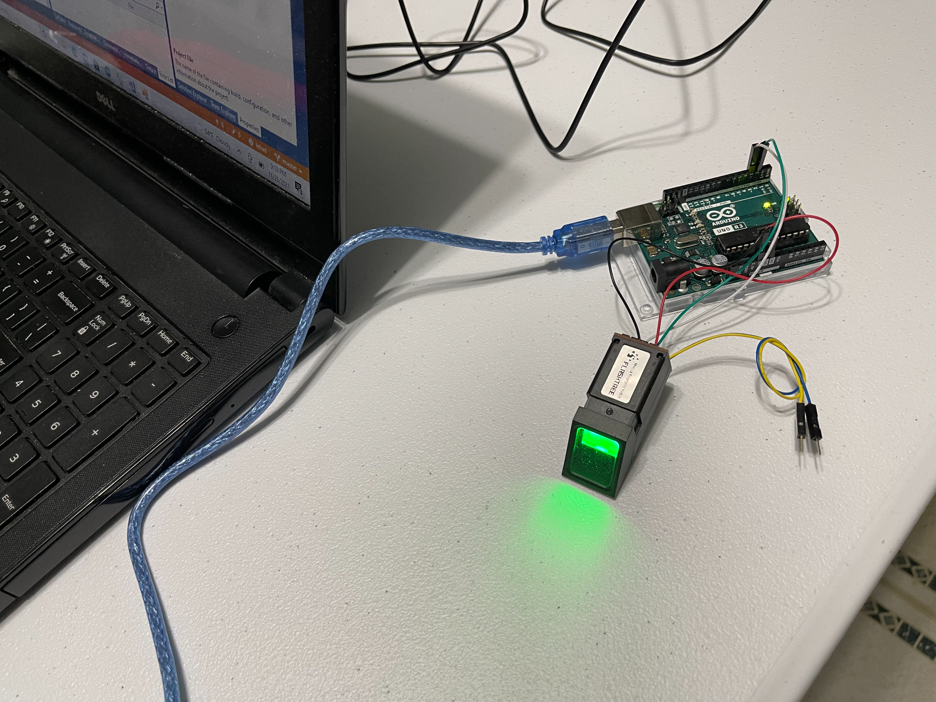
It’s Demo Time

Slide 14
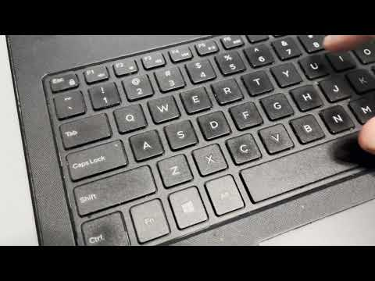
It’s Demo Time

Slide 15
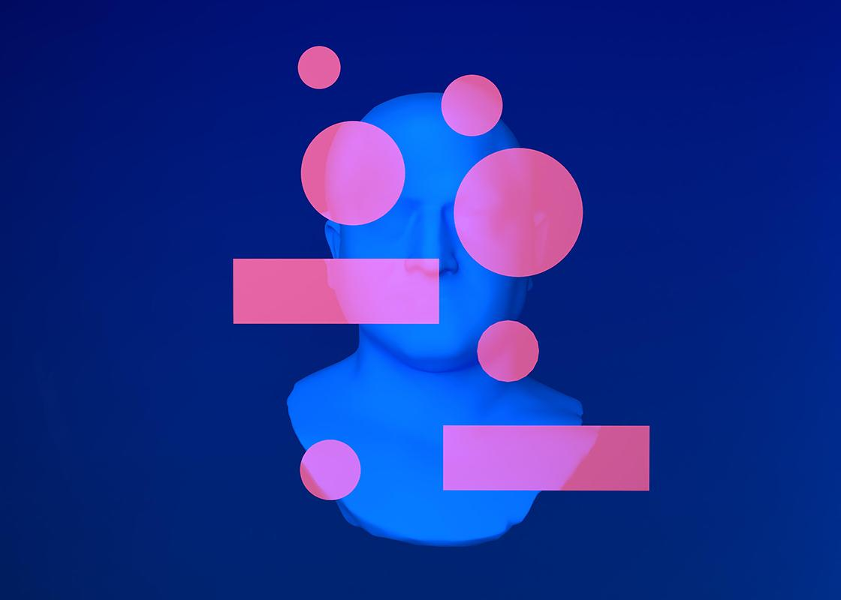


Our team
Bryan Chau
Binh Le
Handling everything.
Buying fingerprint scan on Amazon

Slide 16
THANKS!
BYE
Please keep this slide as attribution

